Slide 1
    Maritime Heritage in Local Communities - Sustainability Models
    10th June, 2016
Funding challenges and sources
Cathy Buchanan, Meitheal Mara, Cork, Ireland

Slide 2
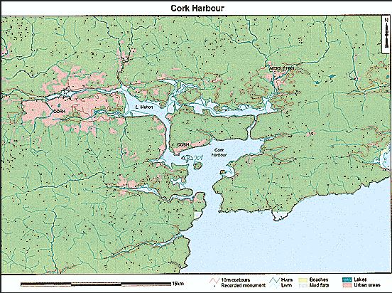

Slide 3
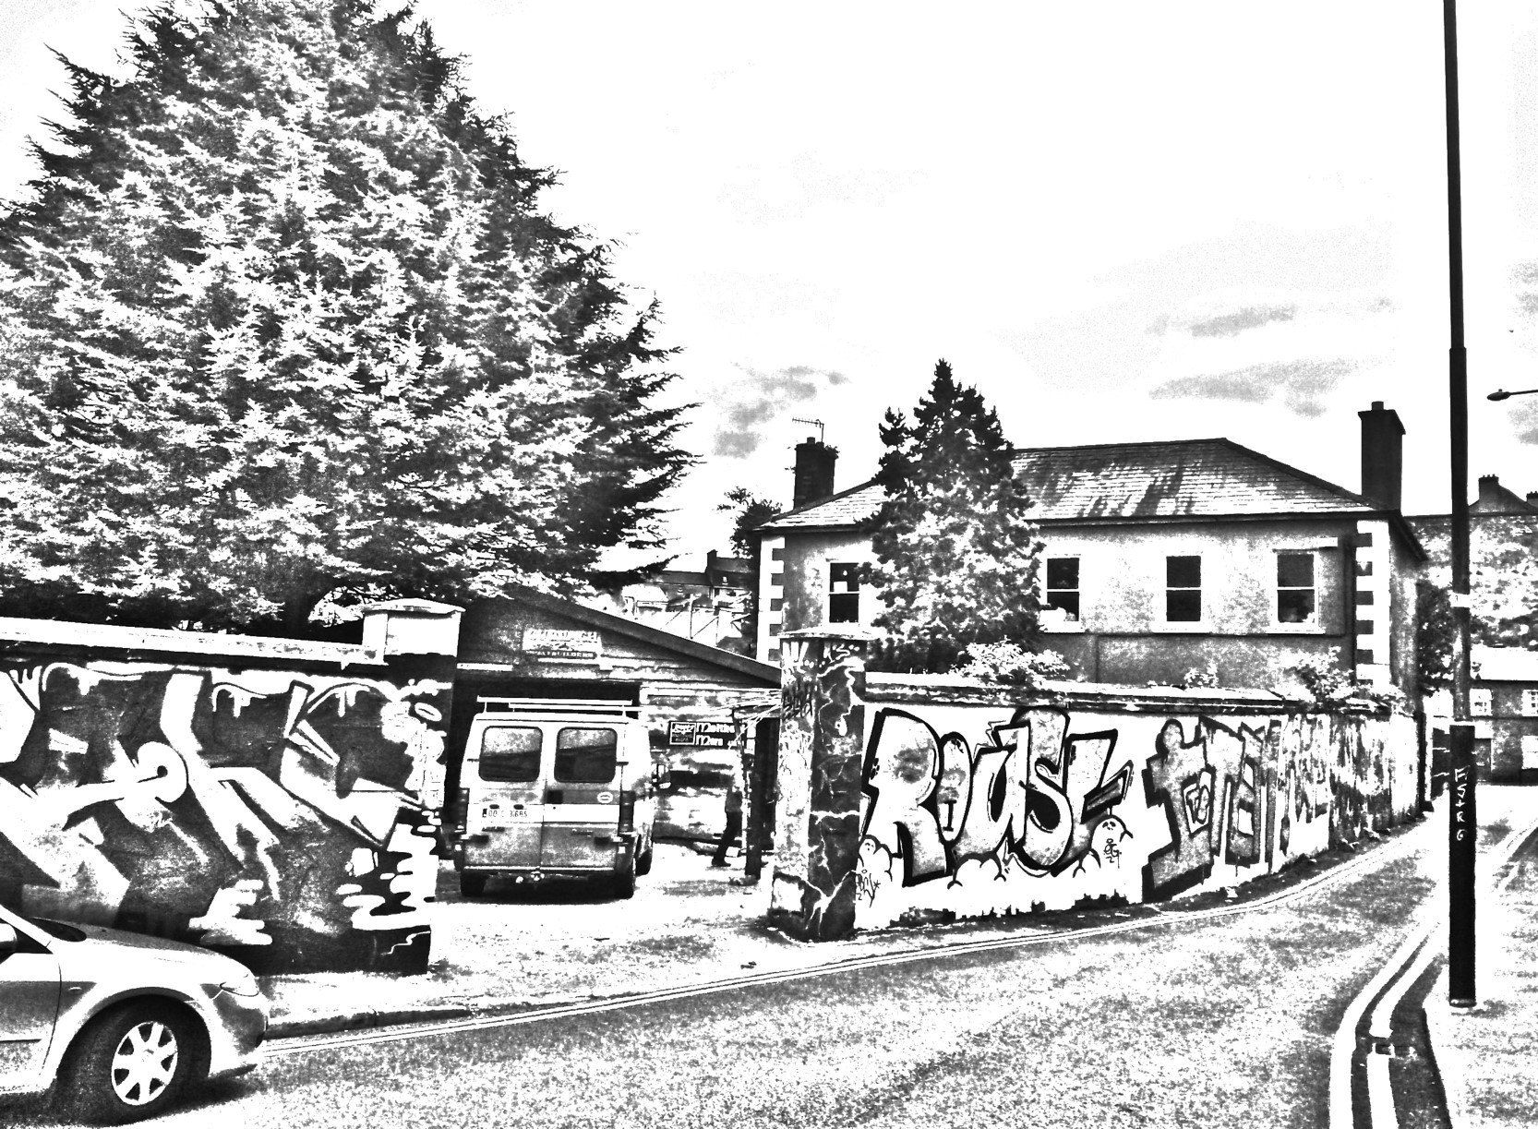

Slide 4
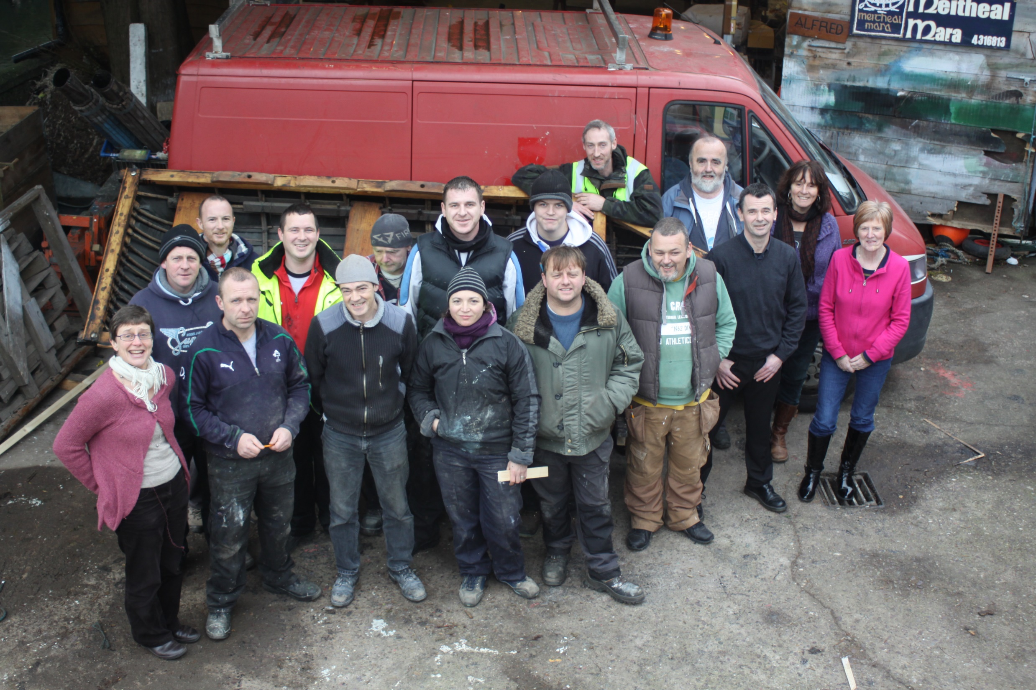

Slide 5
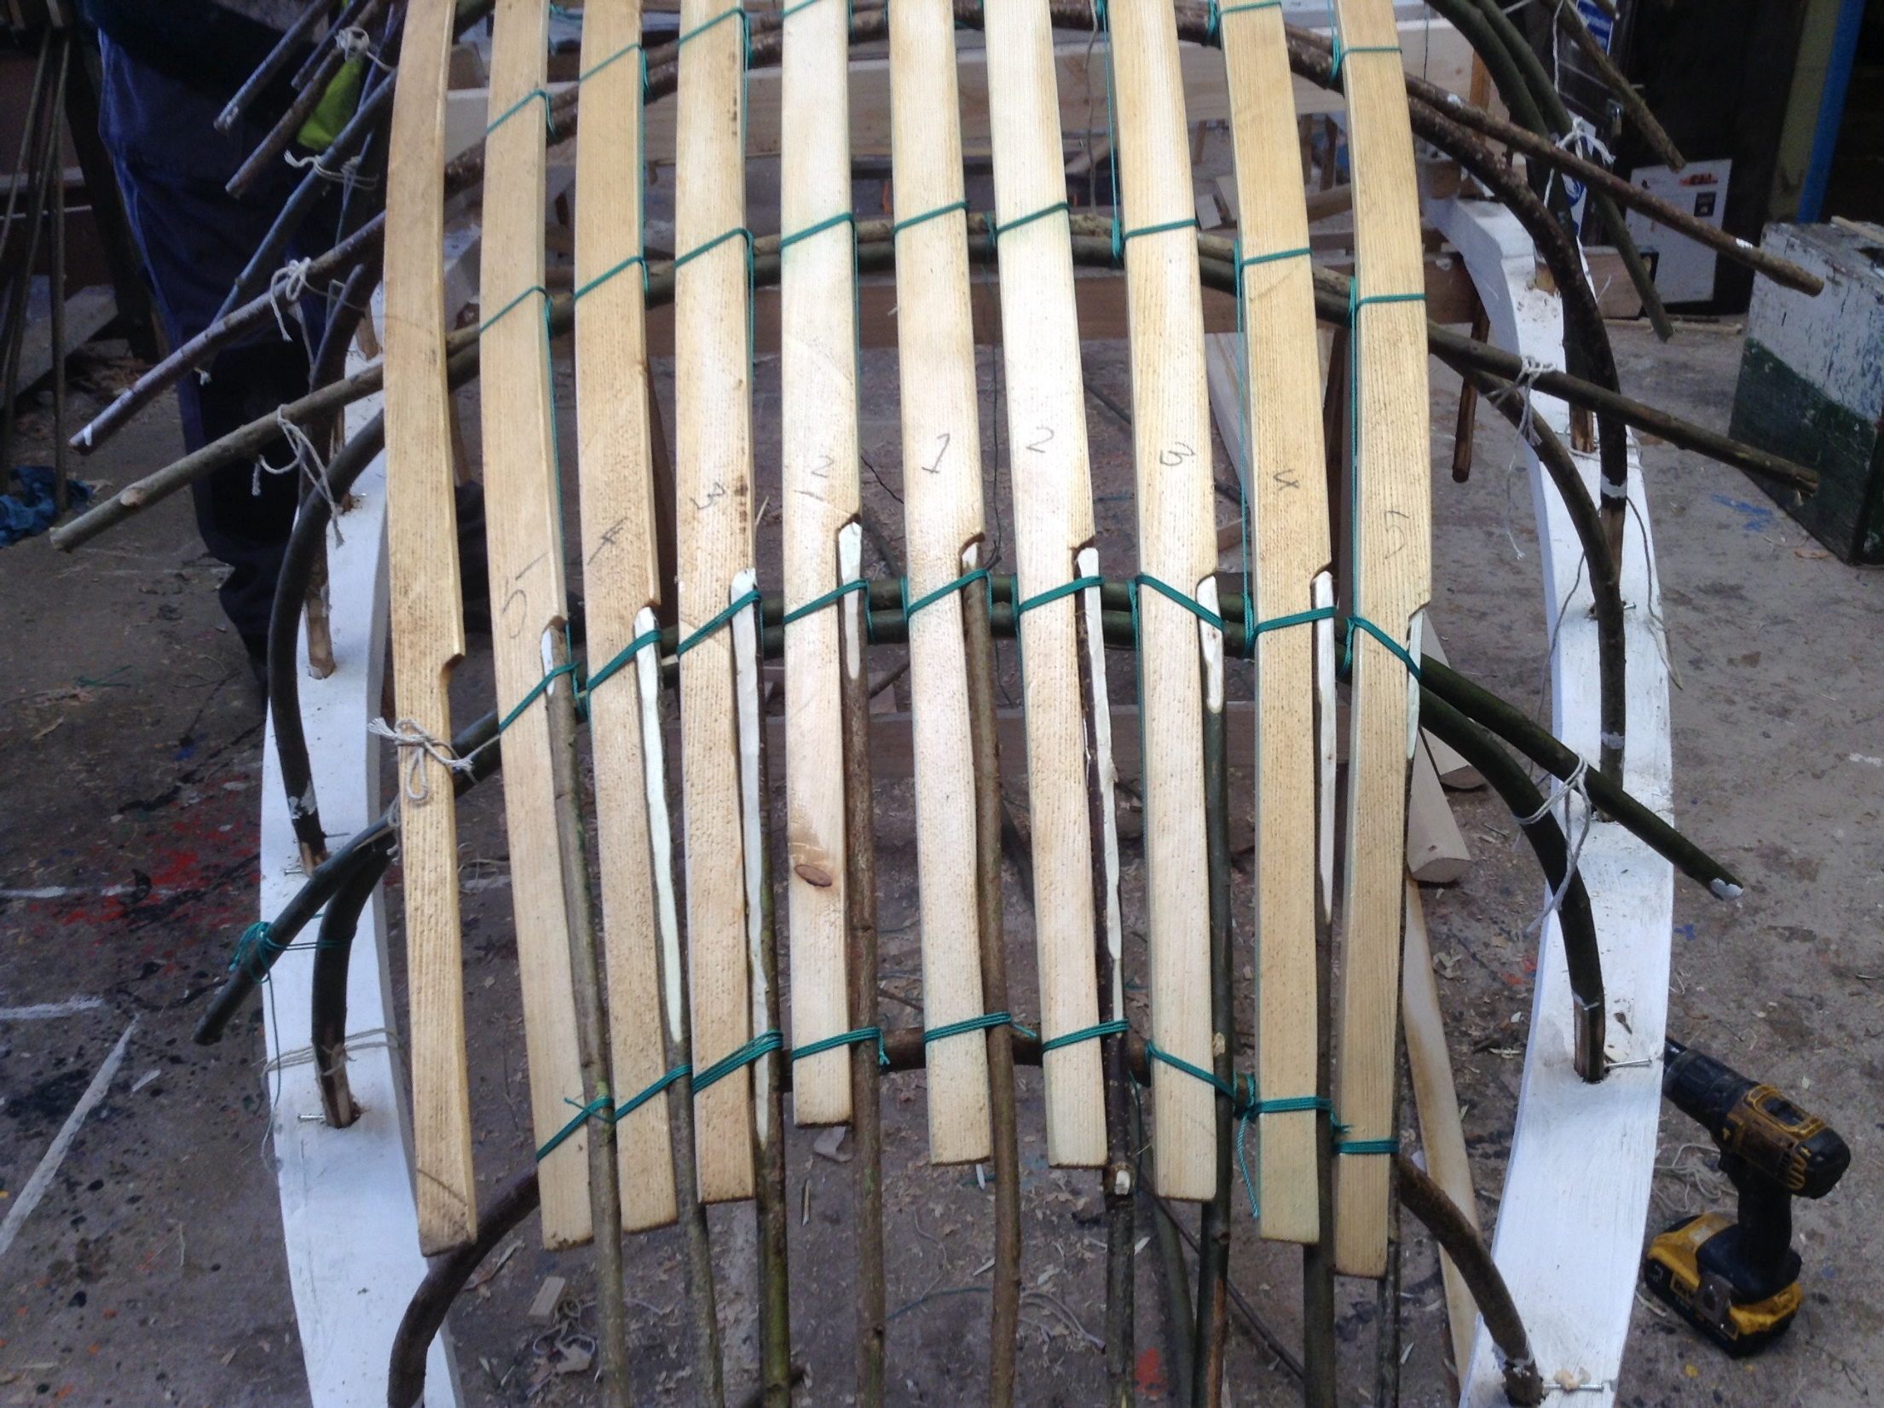

Slide 6
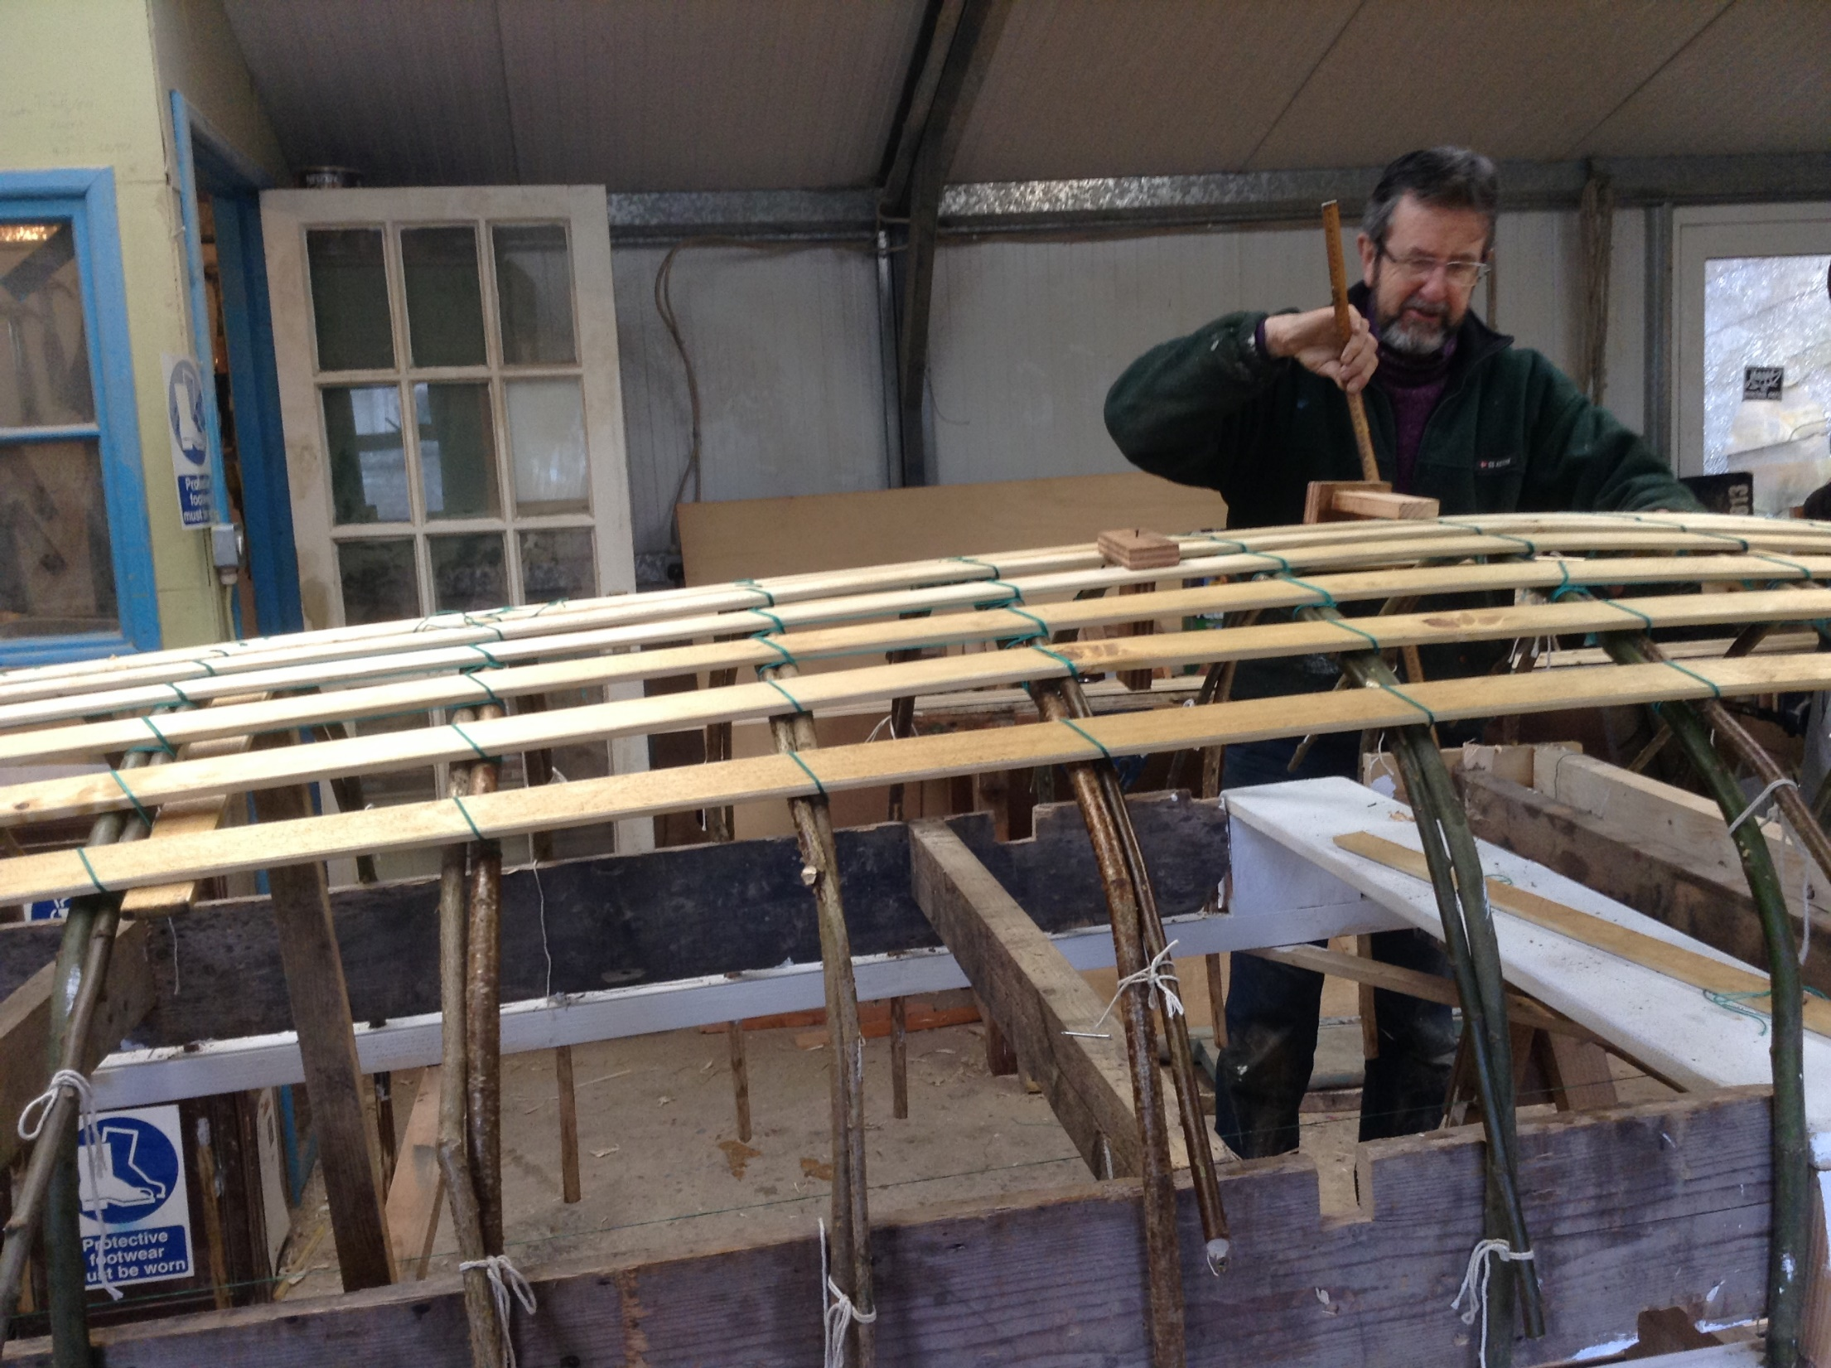

Slide 7
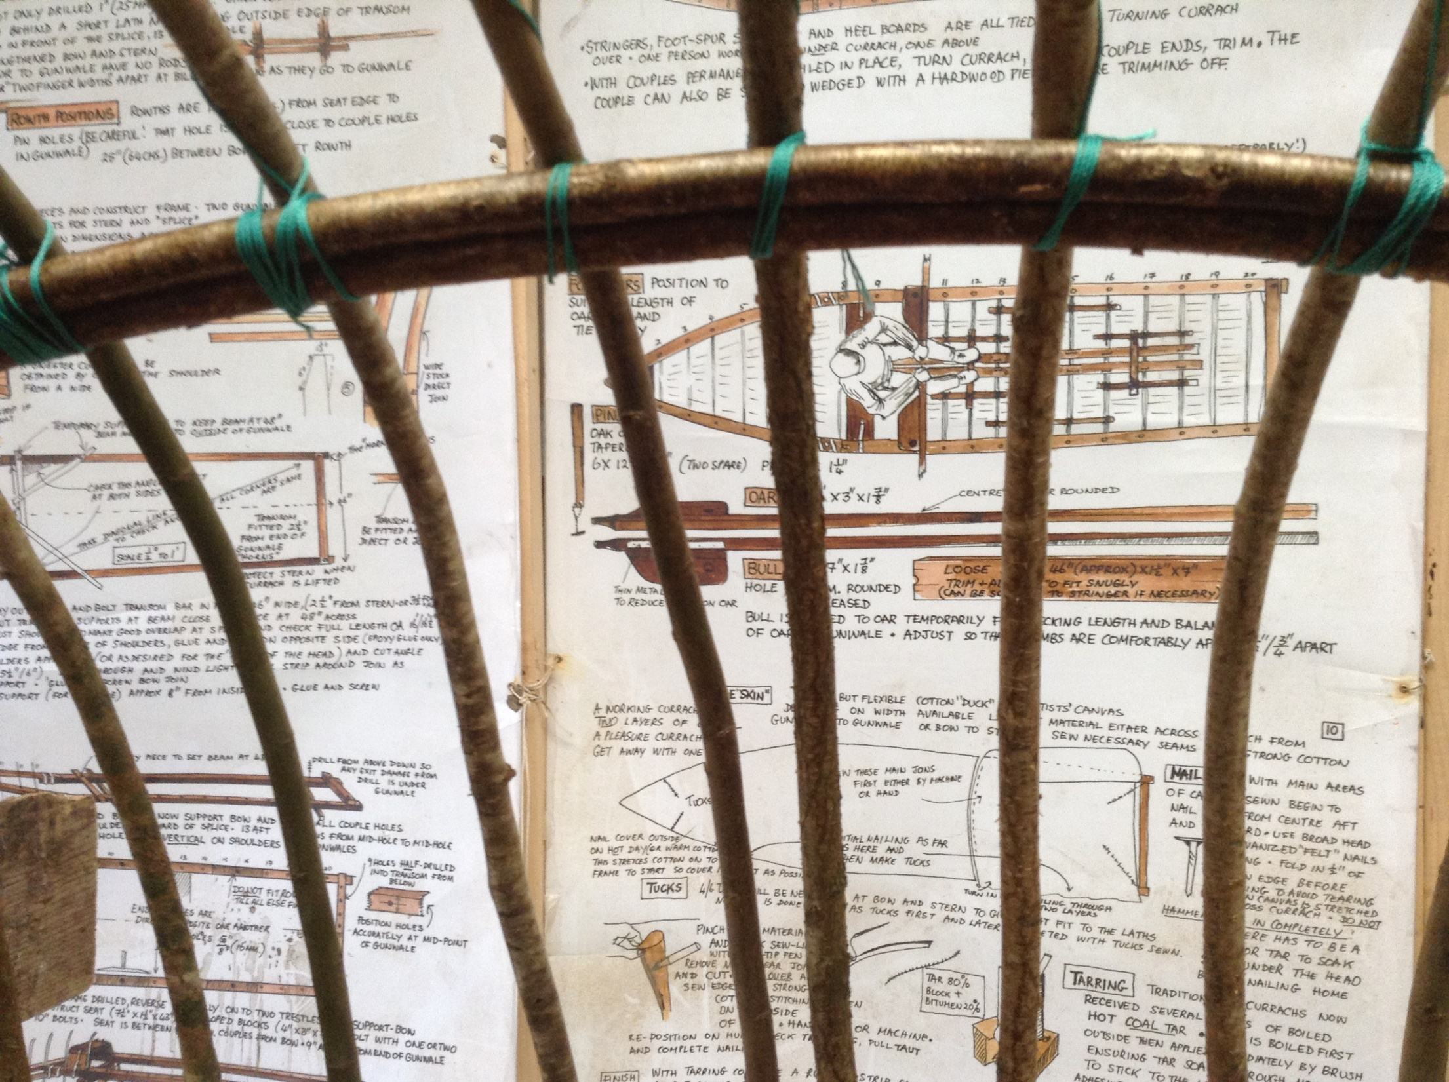

Slide 8
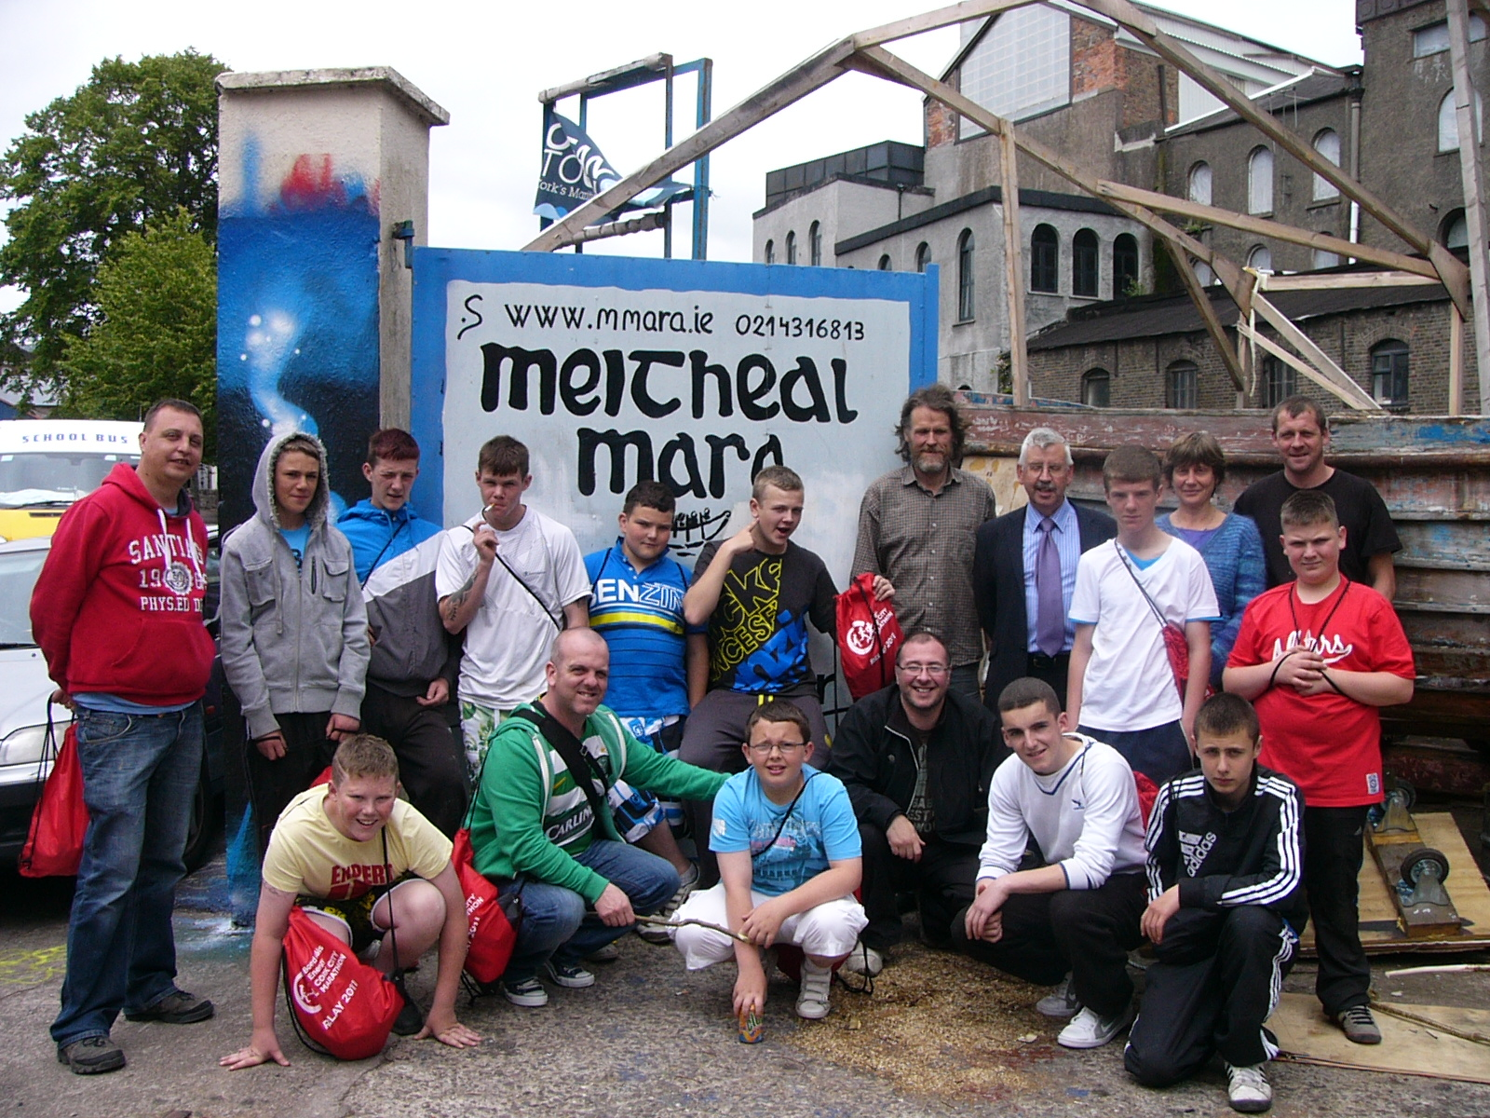

Slide 9
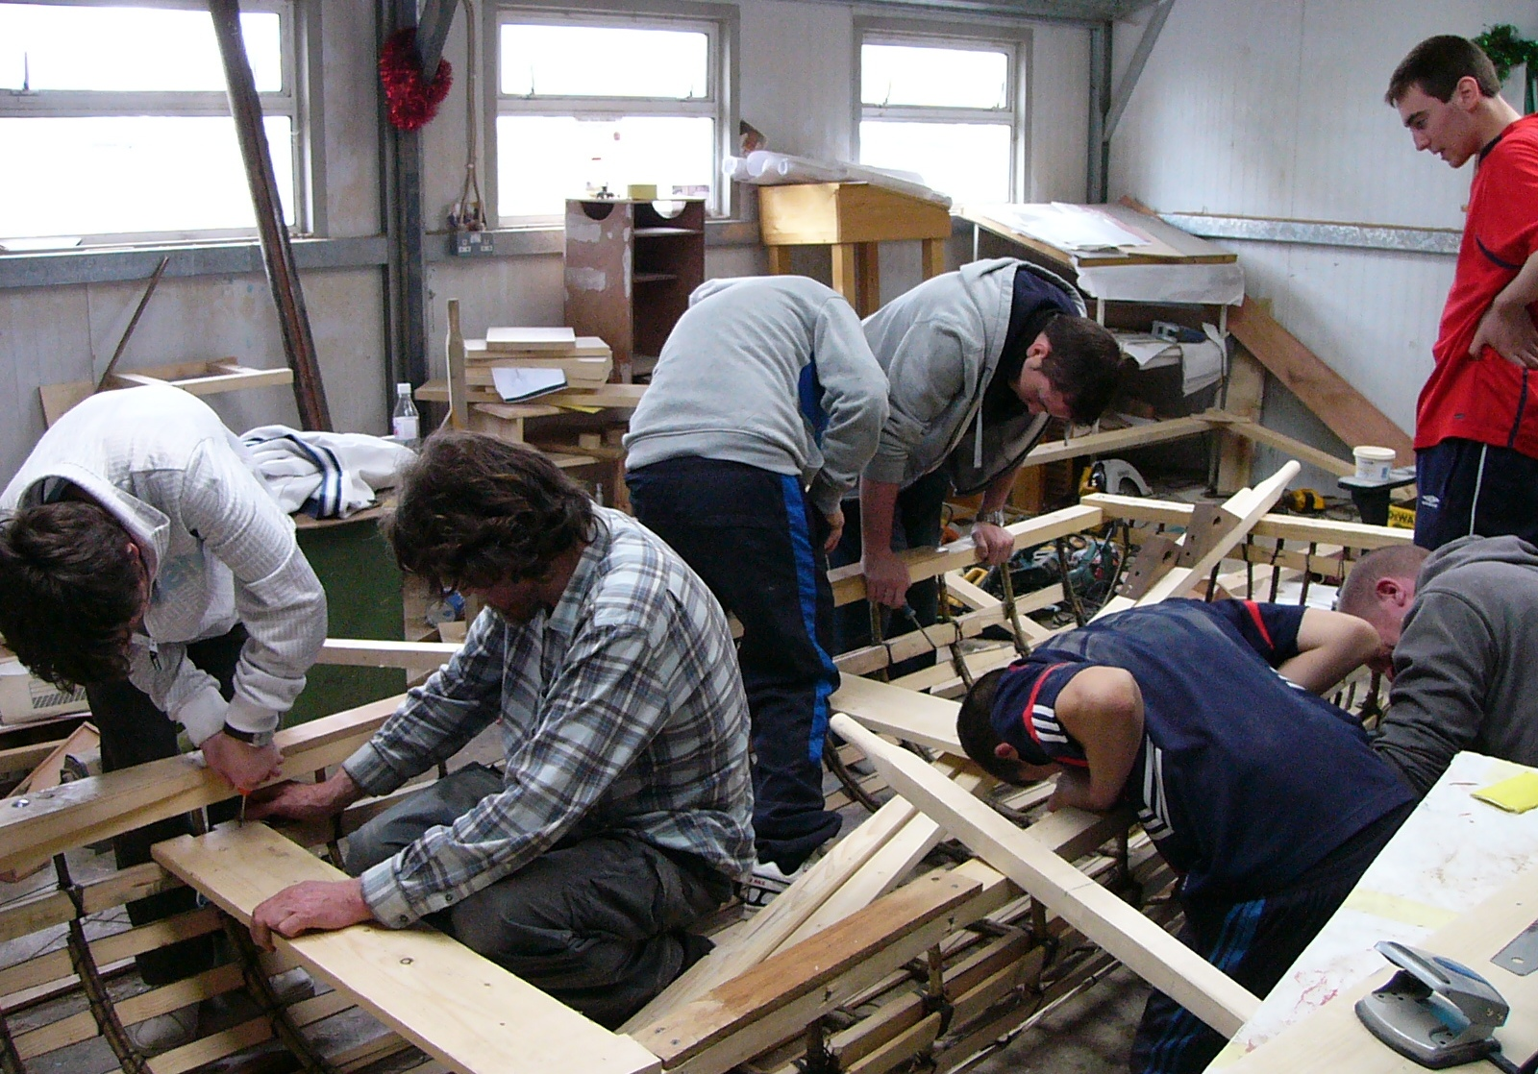

Slide 10
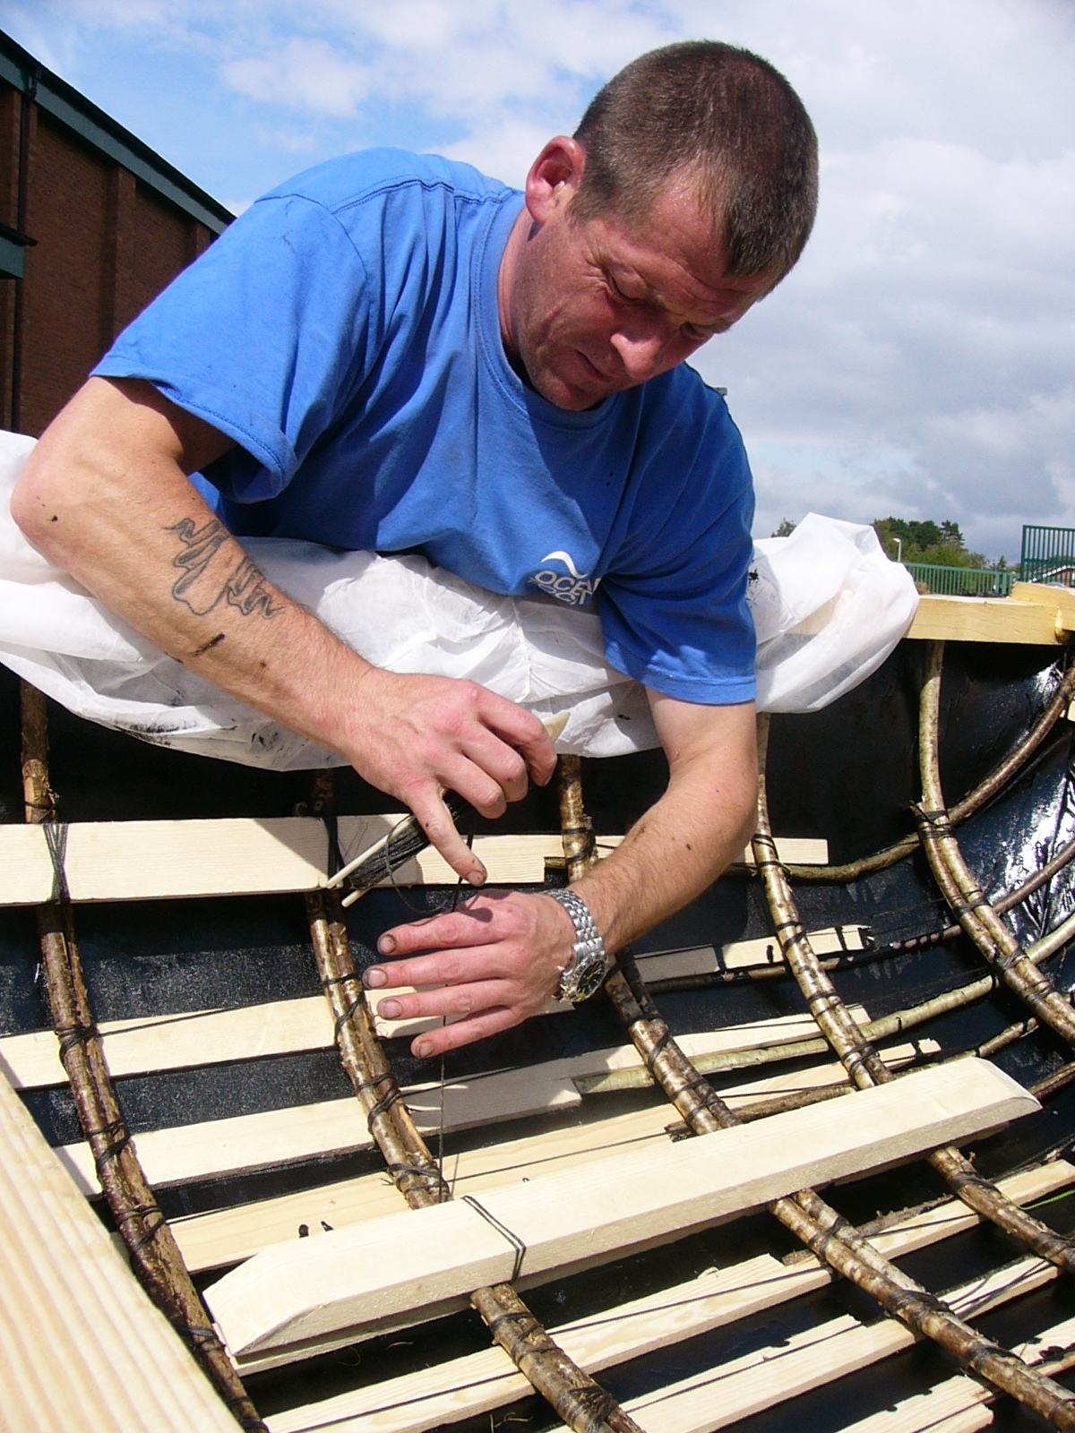

Slide 11
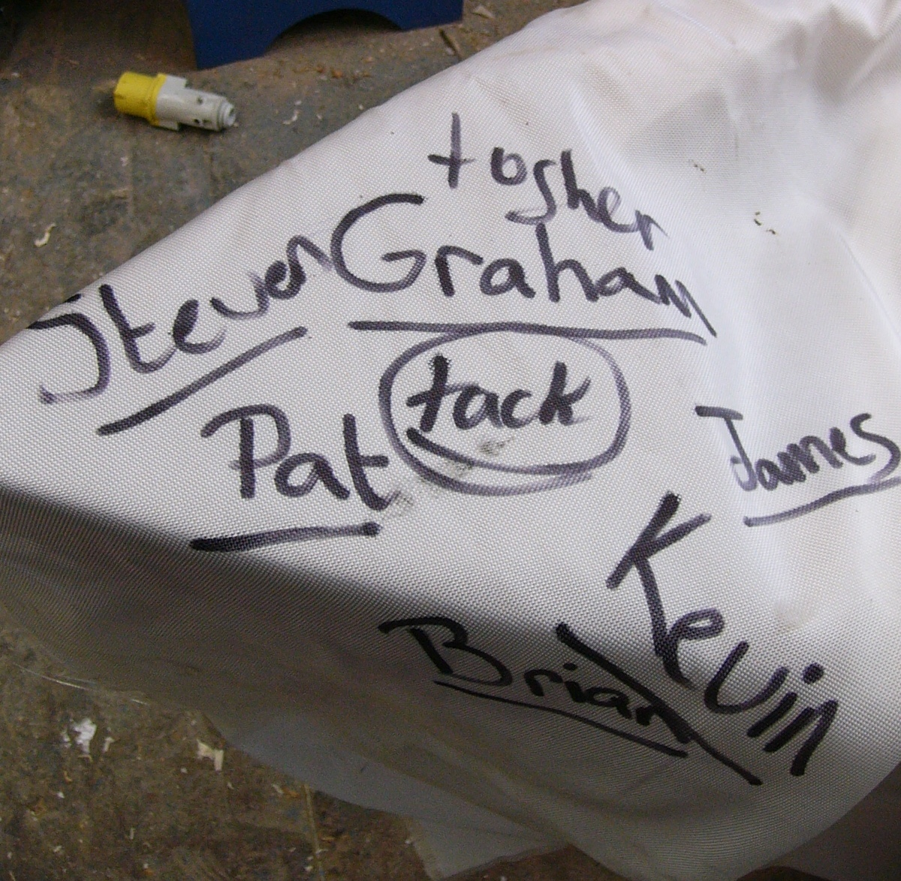

Slide 12
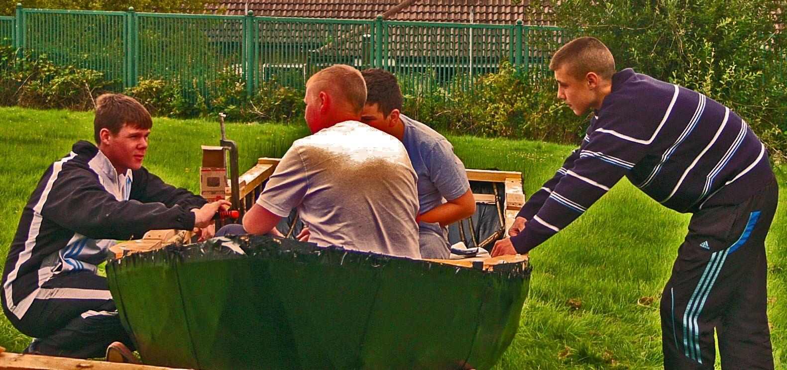

Slide 13
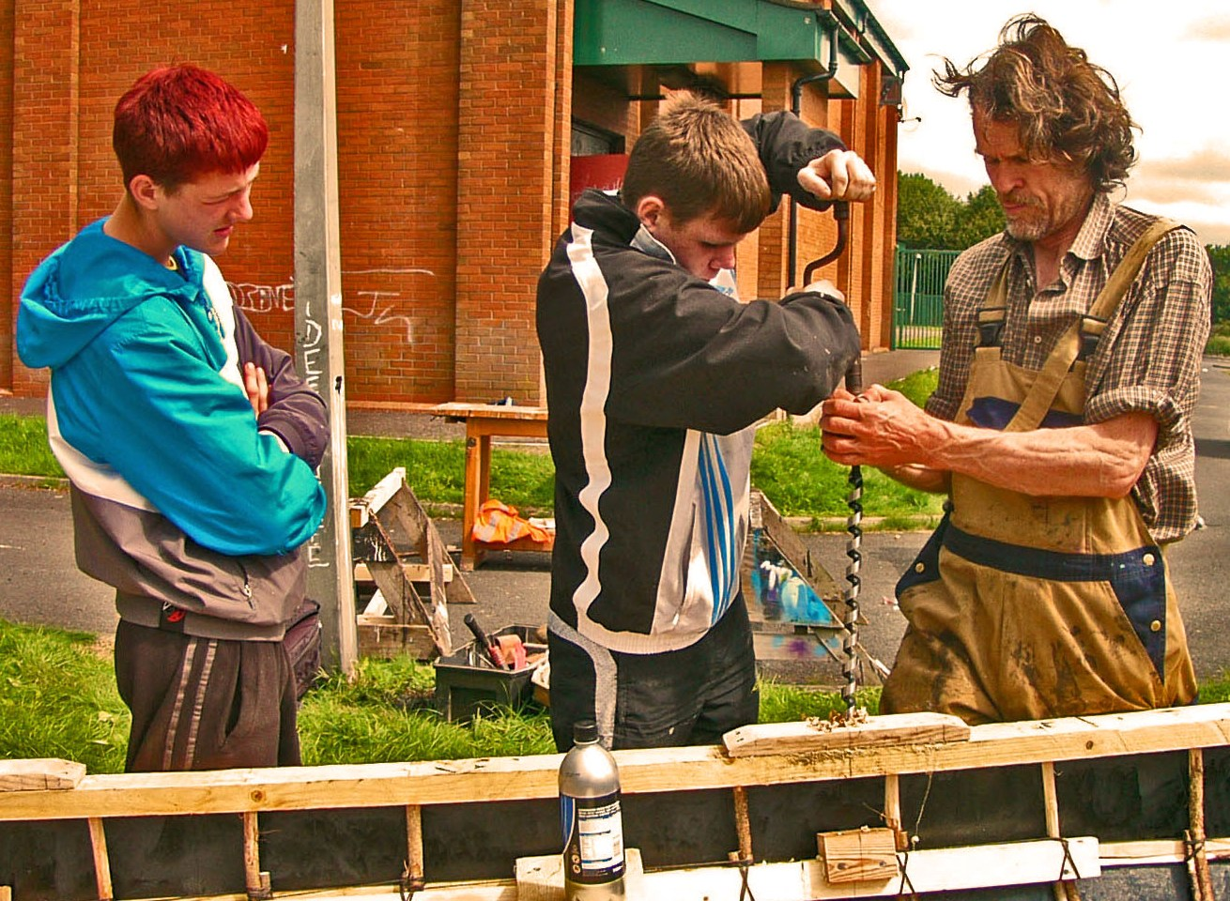

Slide 14
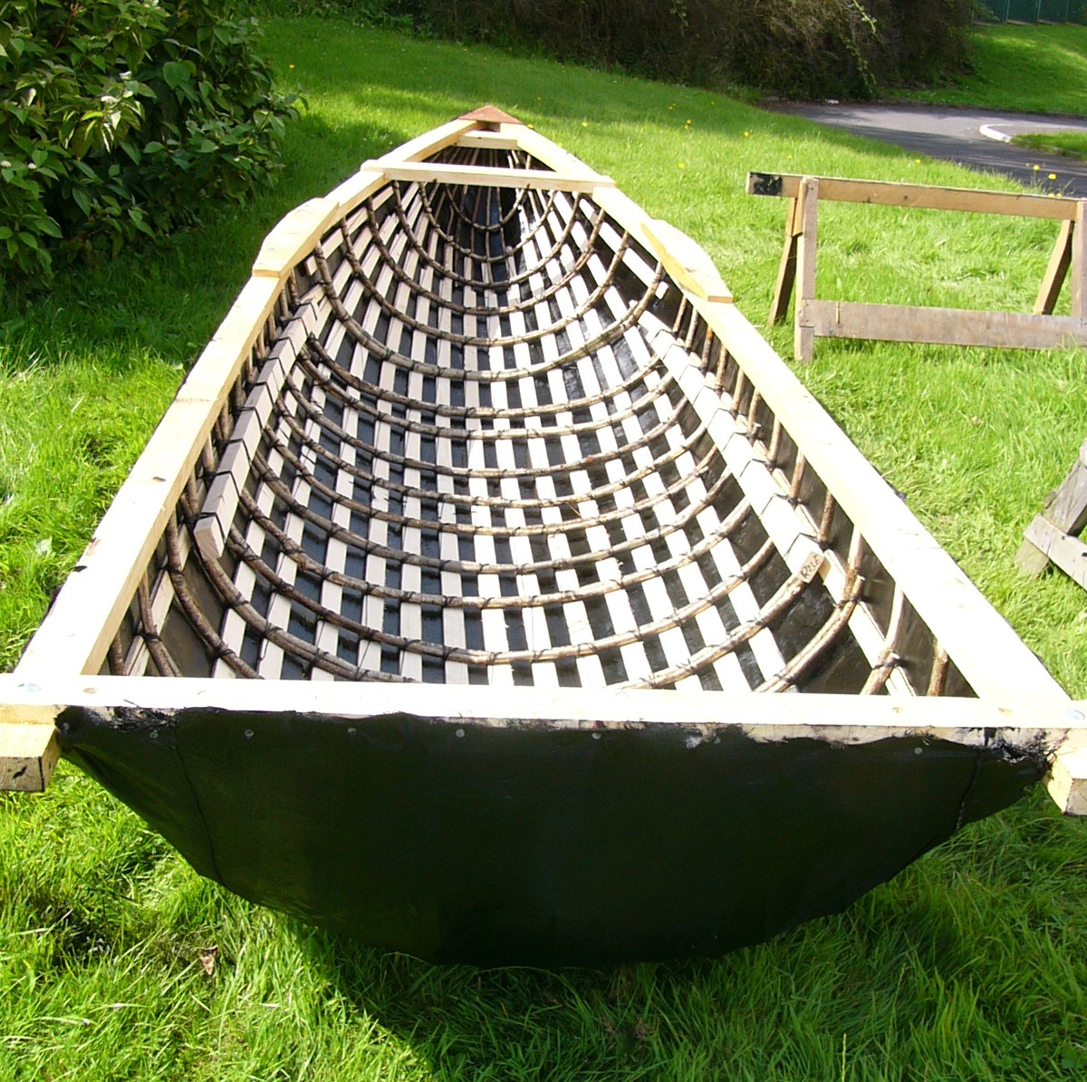

Slide 15
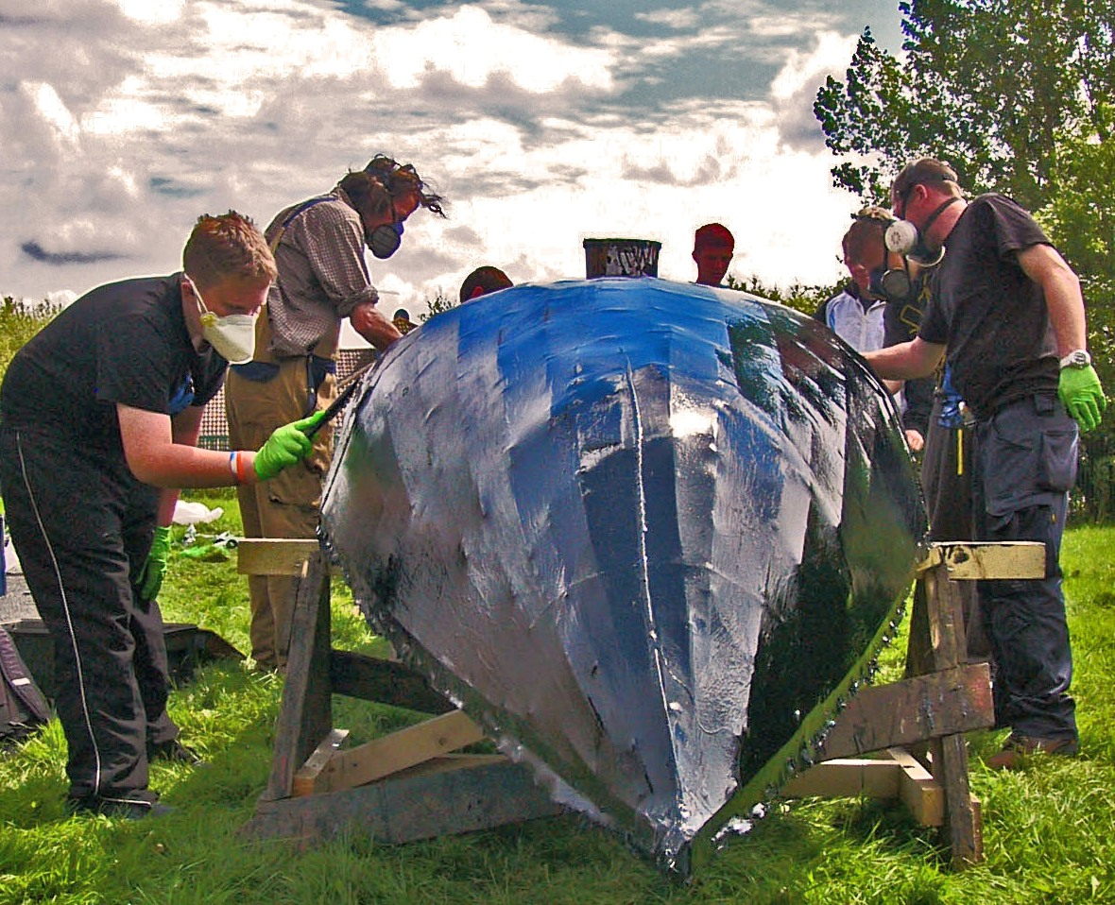

Slide 16
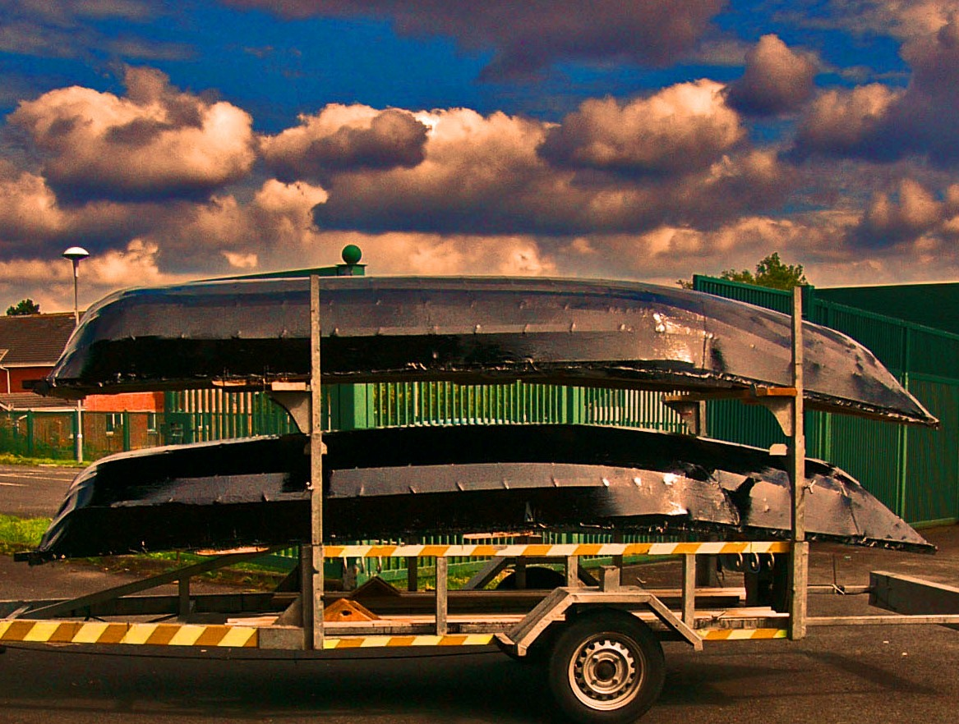

Slide 17
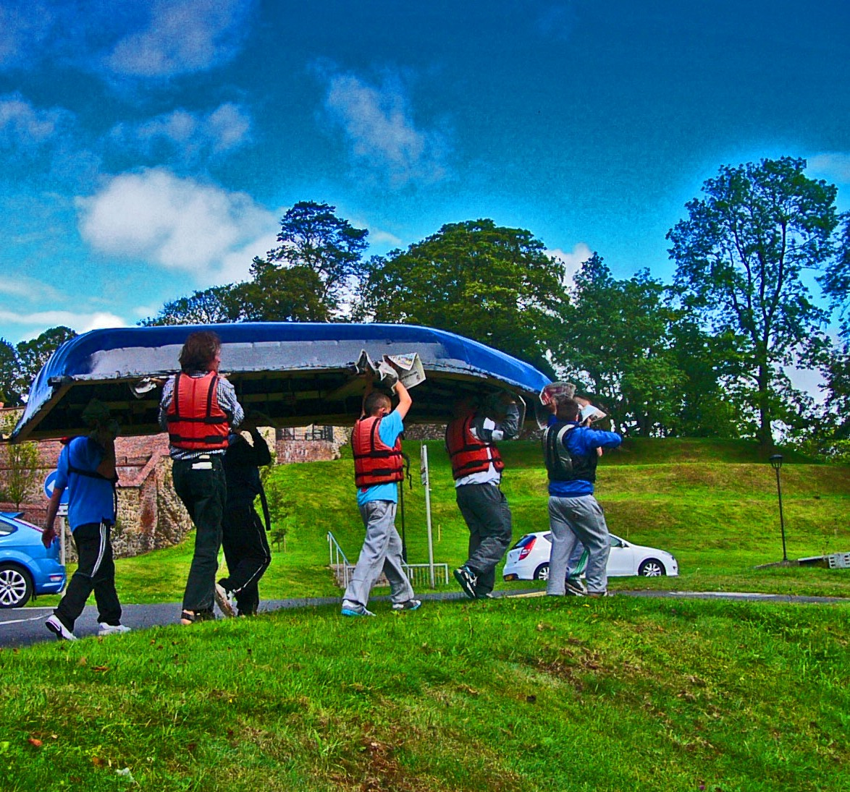

Slide 18
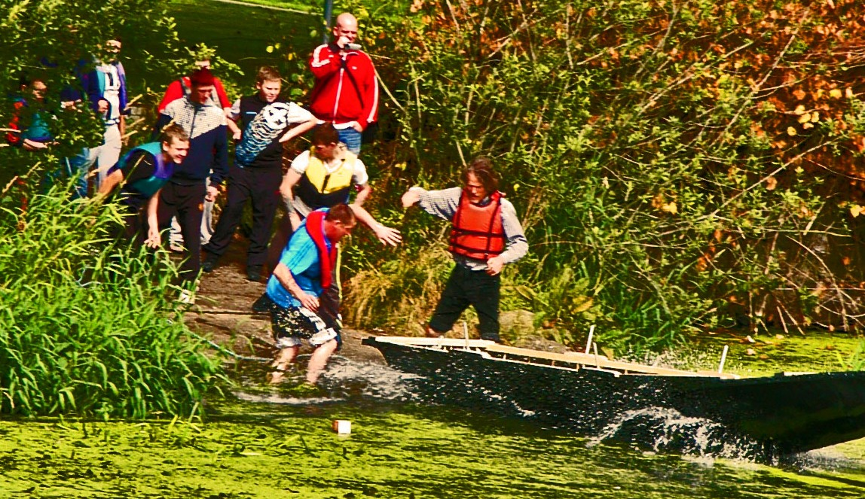

Slide 19
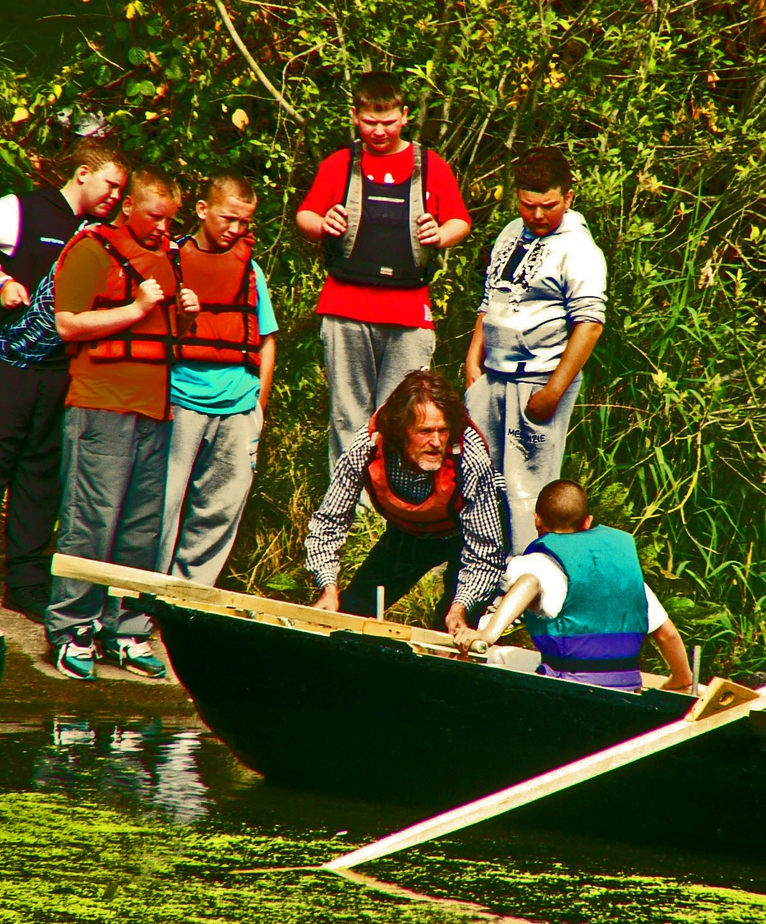

Slide 20
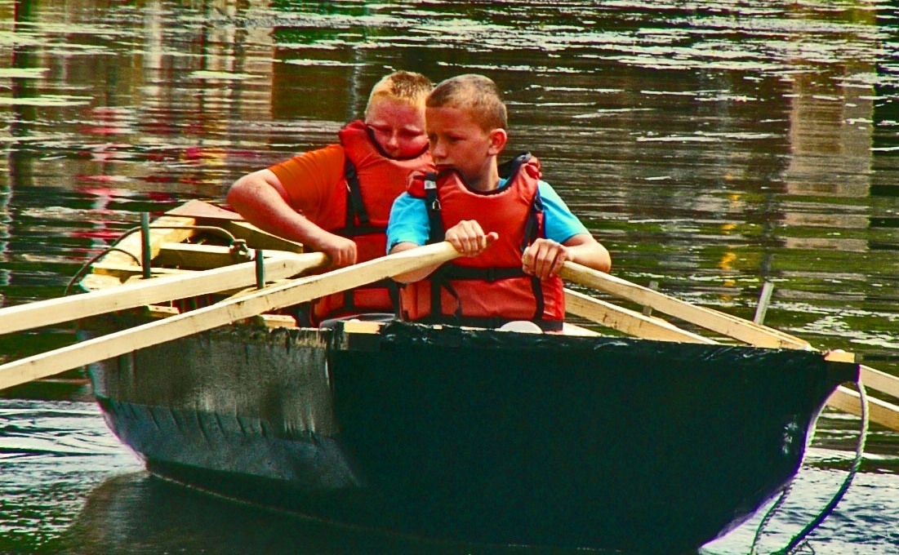

Slide 21
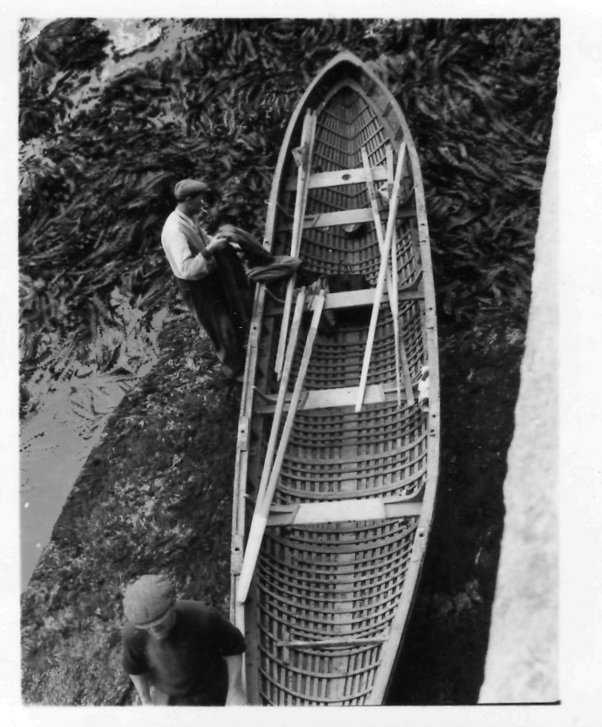

Slide 22
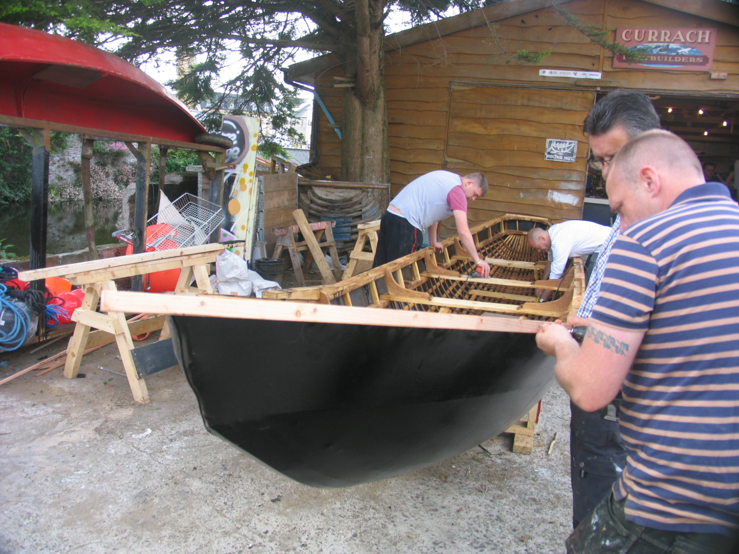

Slide 23
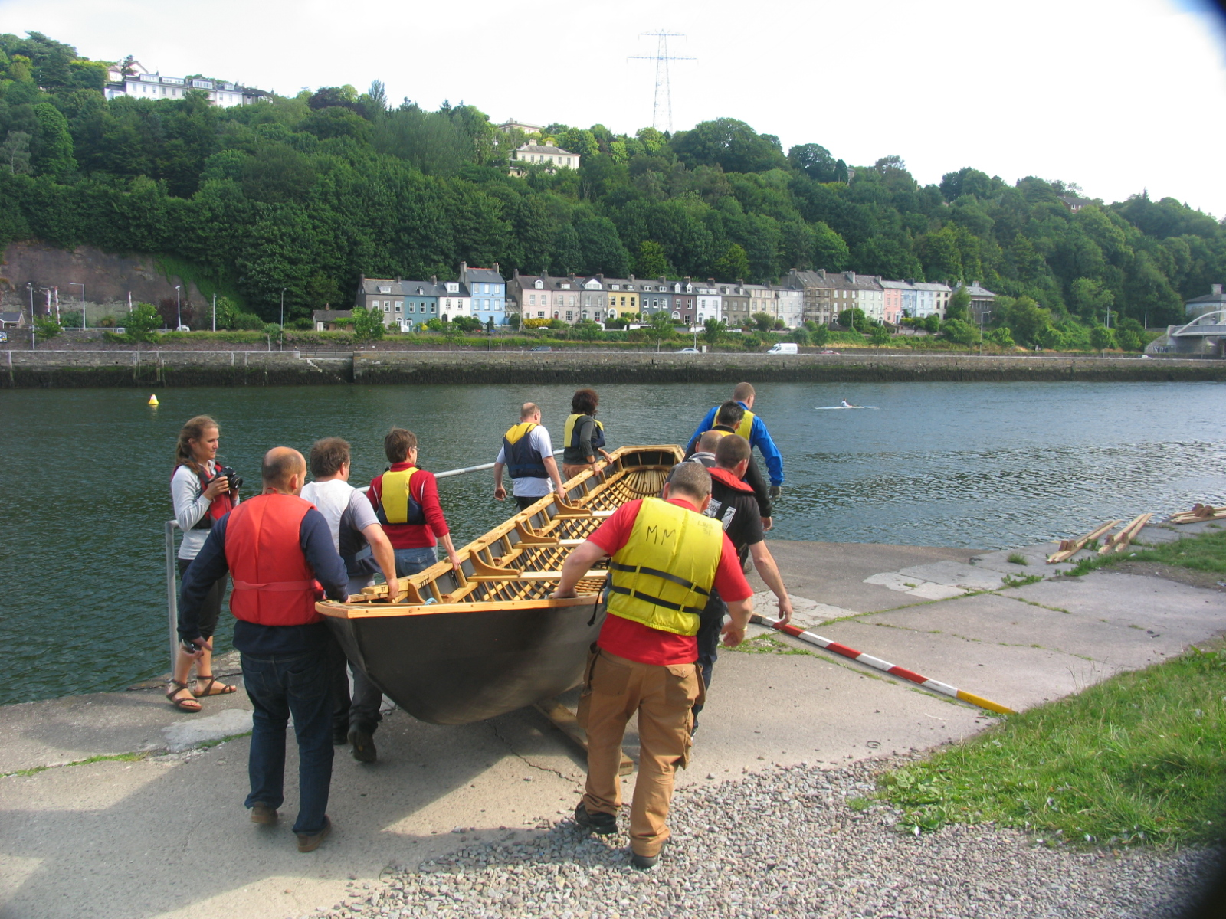

Slide 24
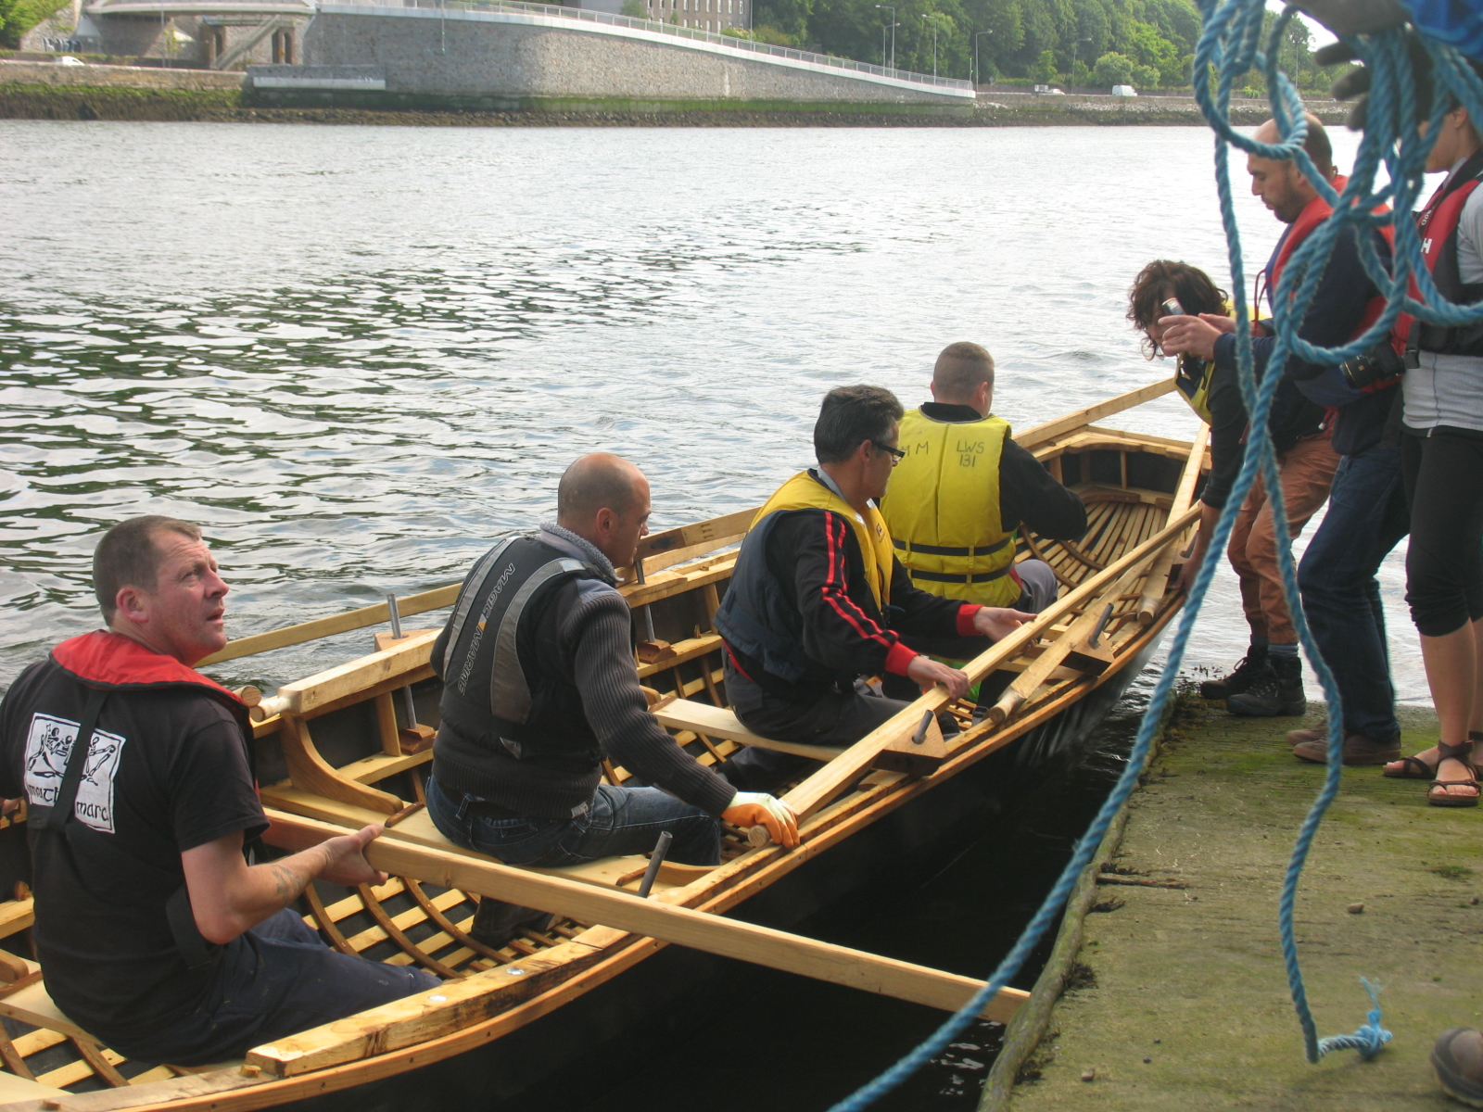

Slide 25
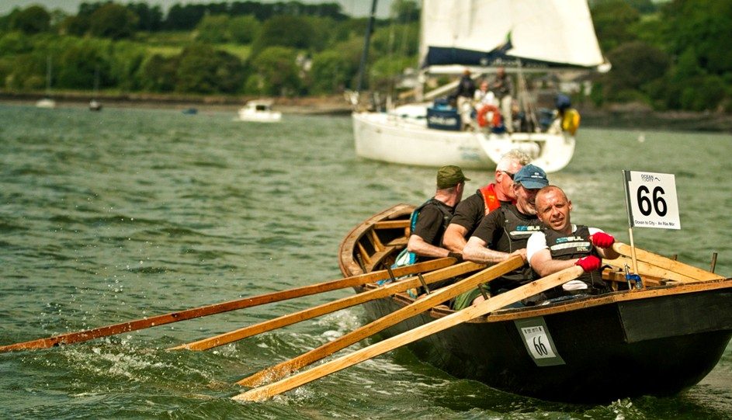

Slide 26
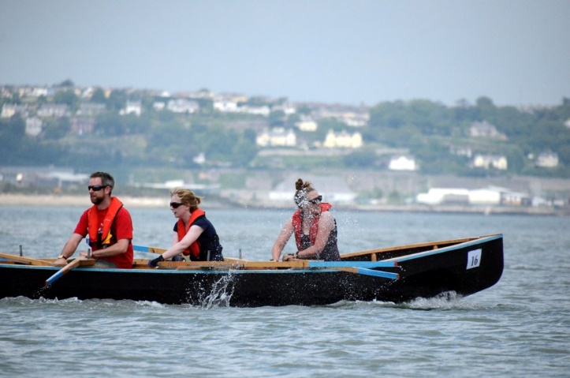

Slide 27
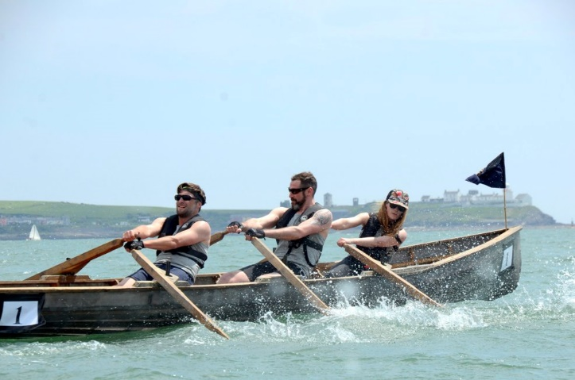

Slide 28
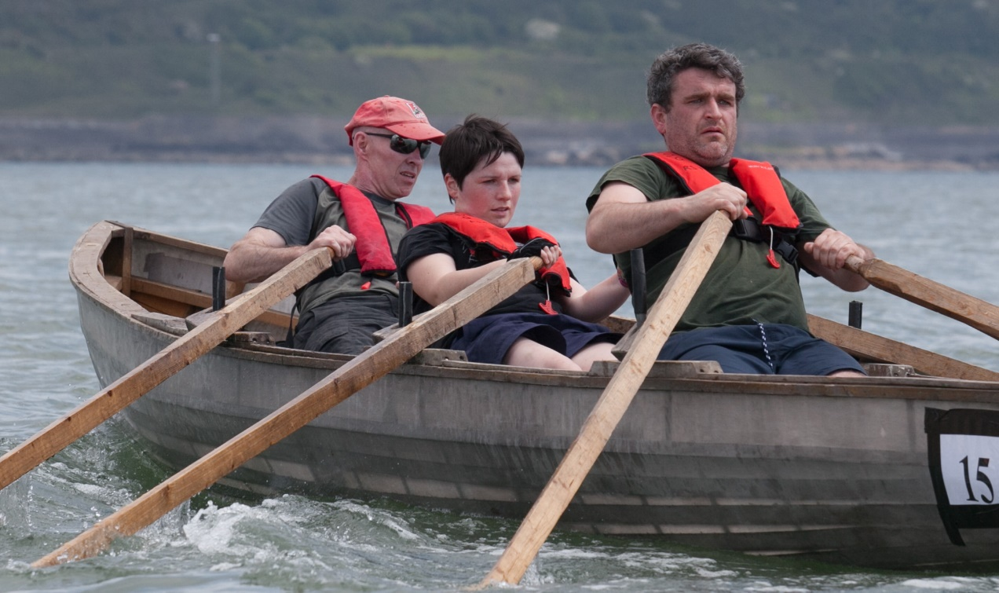

Slide 29
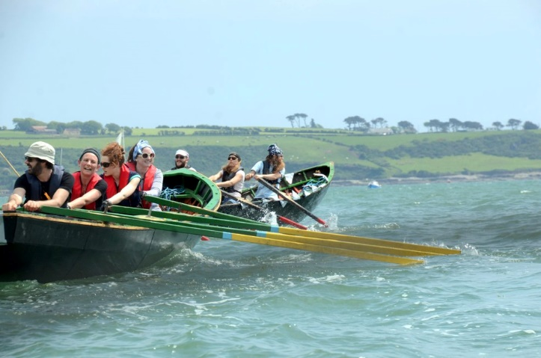

Slide 30
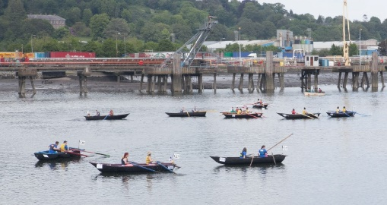

Slide 31
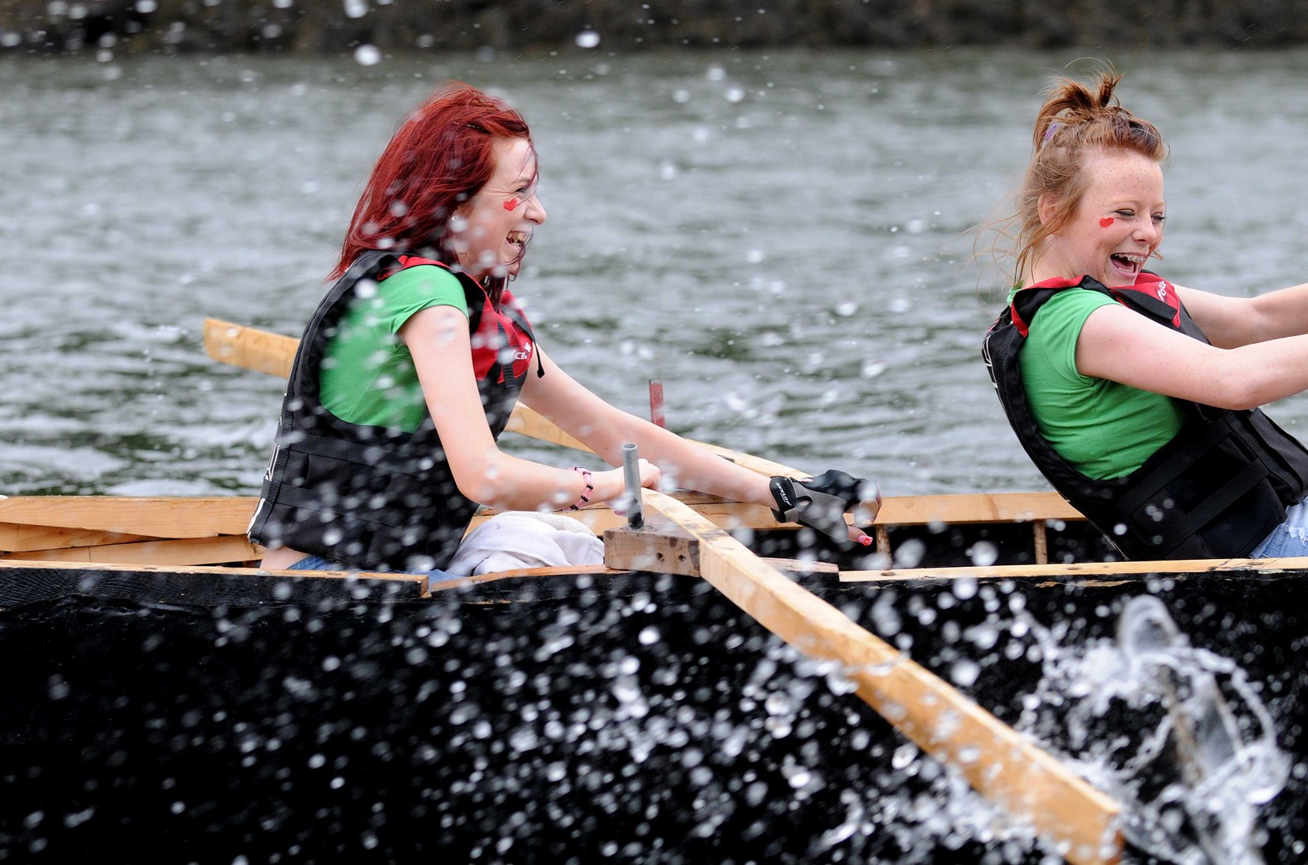

Slide 32
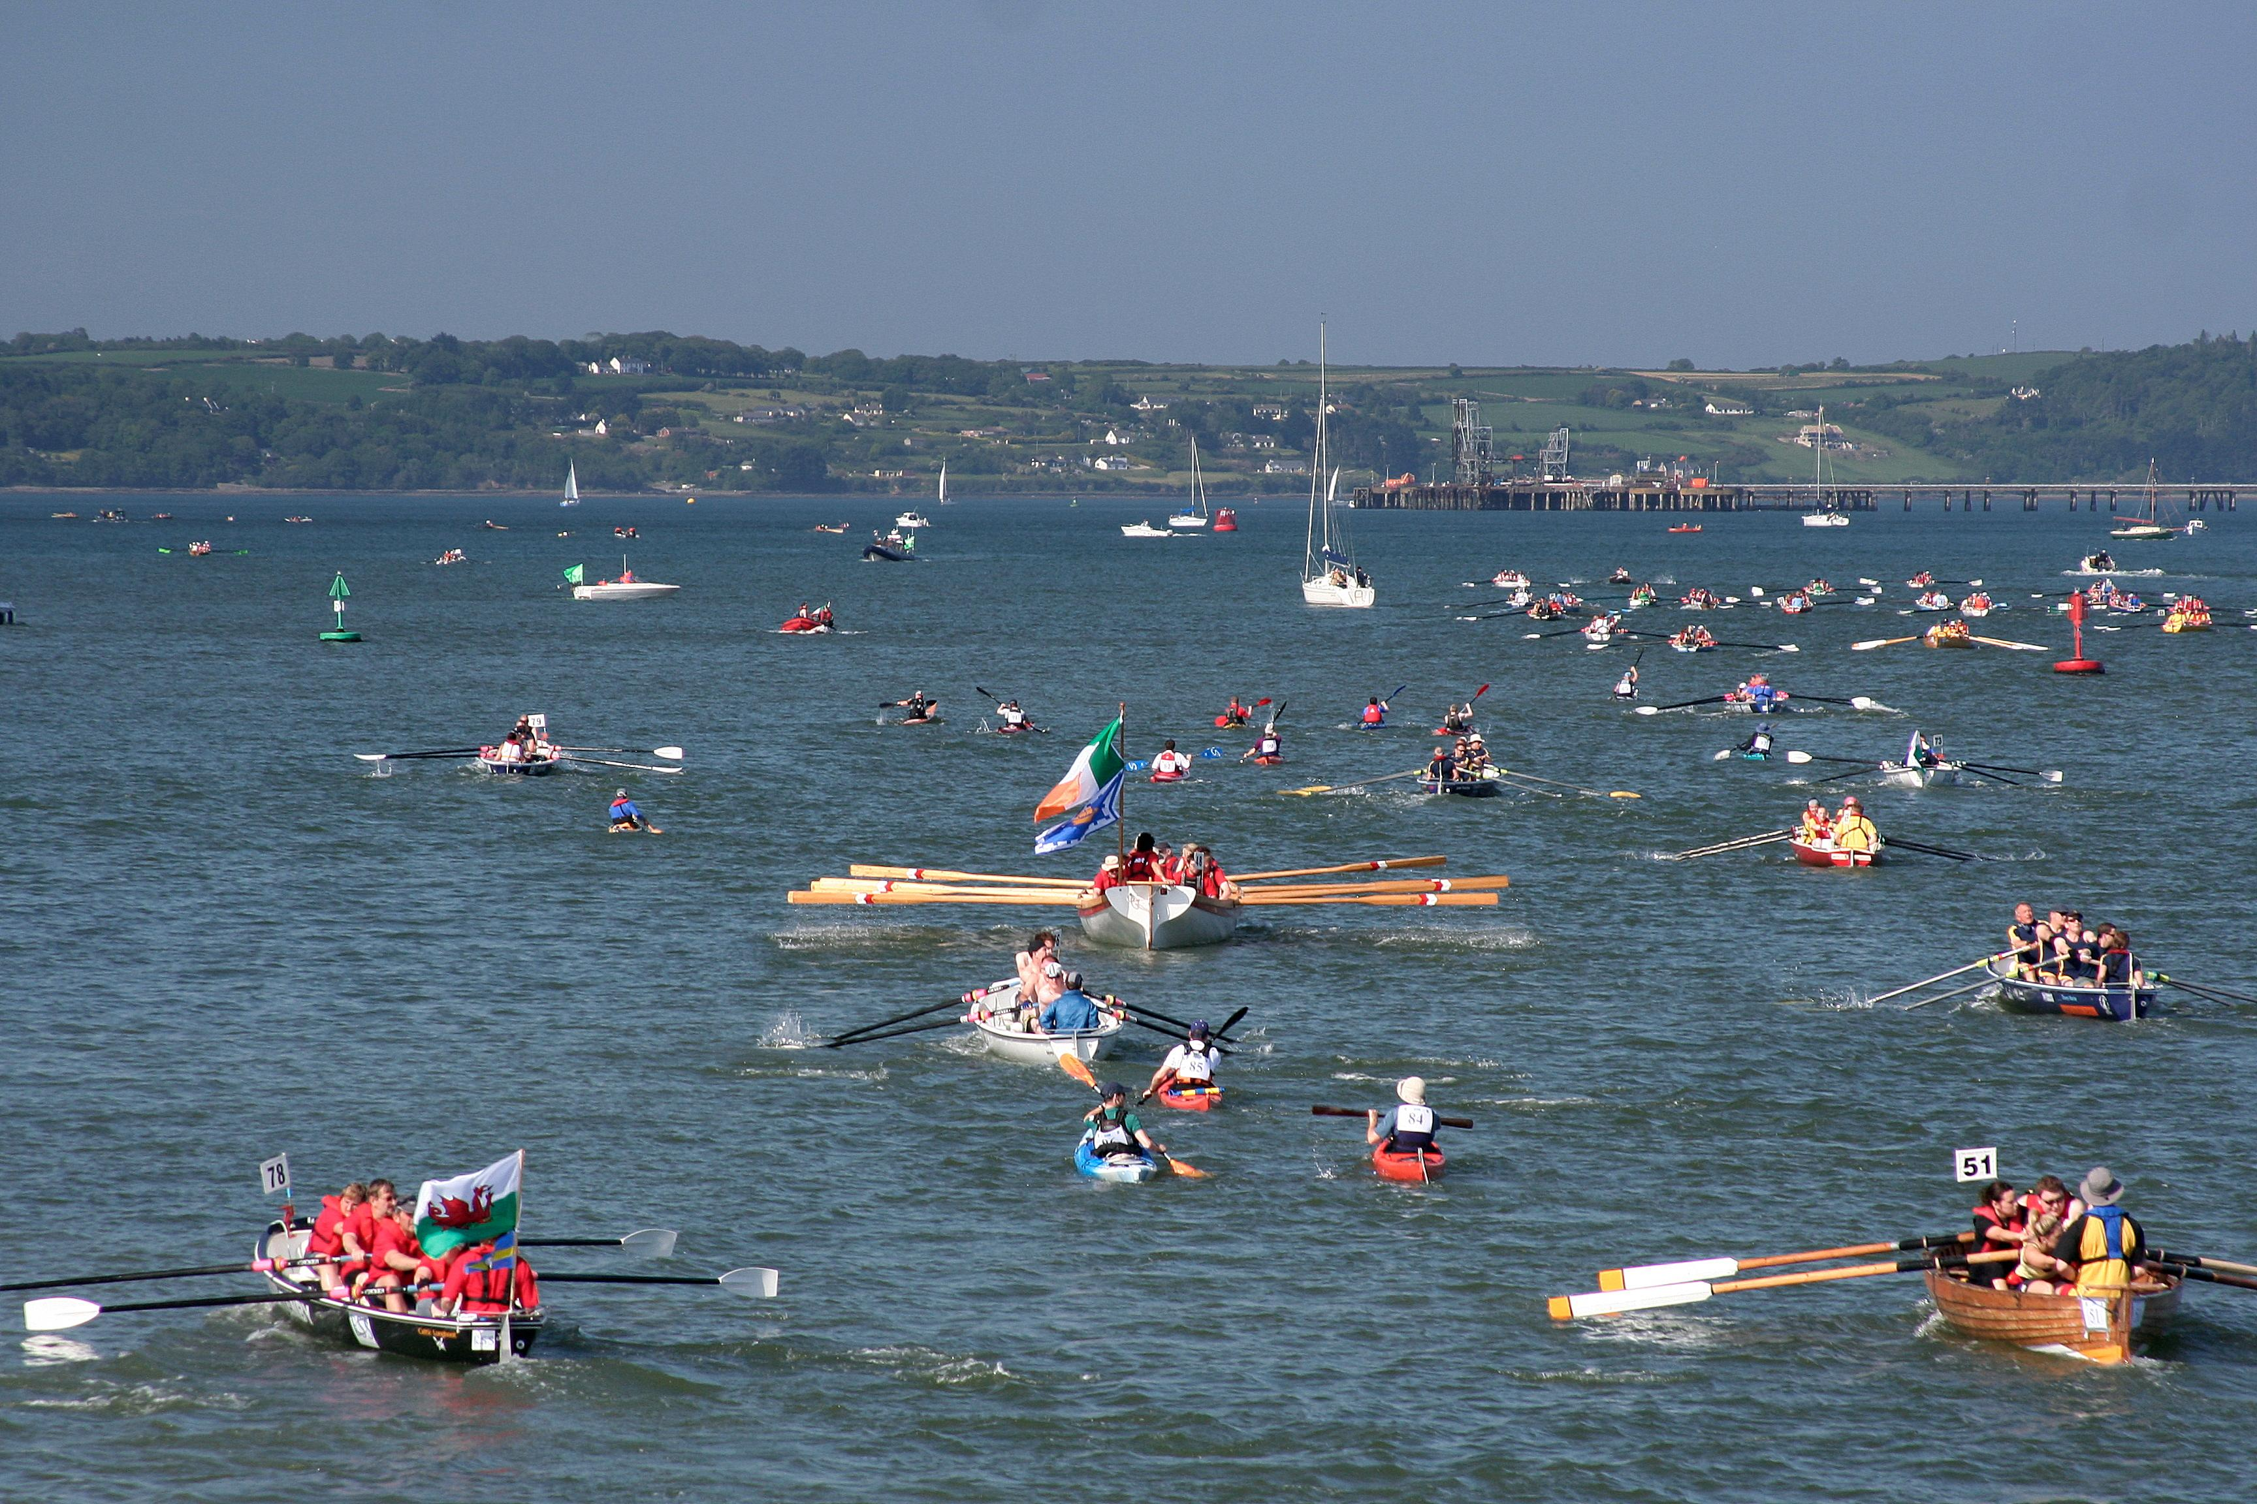

Slide 33
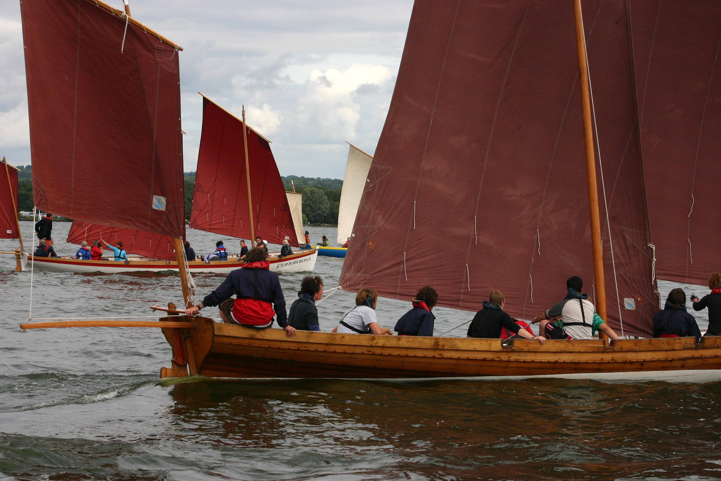

Slide 34
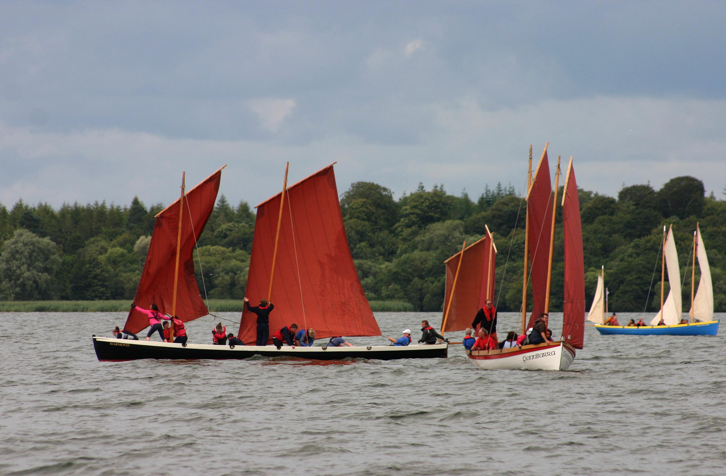

Slide 35
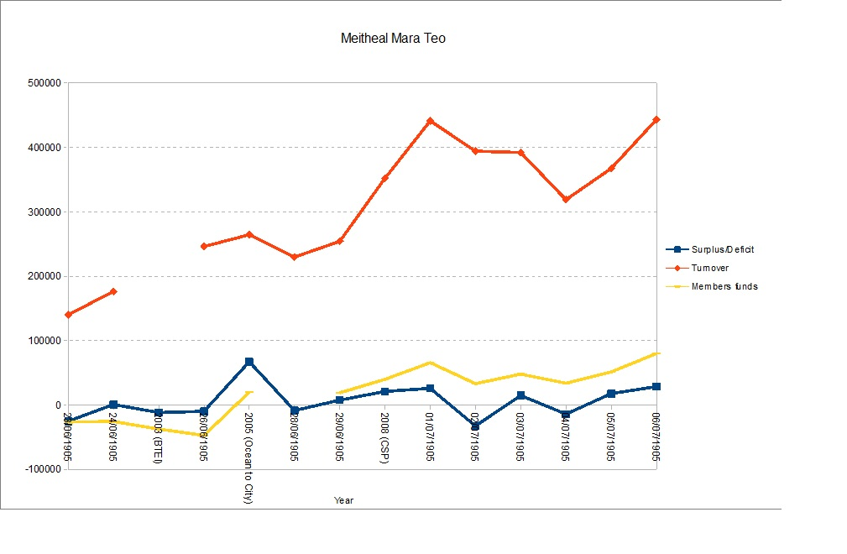

Slide 36
Development of Meitheal Mara
Founded 1993
Community employment scheme 1994
Bádoireacht programme for young people 1999
Back to Education Initiative 2003 (European Social Fund)
Ocean to City 2005 (Cork 2005, European Capital of Culture)
Community Services Programme 2008
EU Boat 2013 – 2015 (Leonardo Lifelong Learning Programme – Learning Partnership with Albaola (Spain), Chantiers Tramasset (France) and Euclides (Belgium)

Slide 39
People - volunteers and community employment participants
Meitheal Mara Board of Directors (8 members, volunteers)
Committees (6 further volunteers)
Fionnbarra adult crew (5)
Community employment – up to 12 people at any one time
Cork Harbour Festival and Ocean to City
  12 volunteers, core team
  300+ volunteers for events

